Slide 1
Titanic
Machine Learning from Disaster
Gene Olafsen

Slide 2
Tragedy
The sinking of the RMS Titanic is one of the most infamous shipwrecks in history. On April 15, 1912, during her maiden voyage, the Titanic sank after colliding with an iceberg, killing 1502 out of 2224 passengers and crew. This sensational tragedy shocked the international community and led to better safety regulations for ships.
One of the reasons that the shipwreck led to such loss of life was that there were not enough lifeboats for the passengers and crew. Although there was some element of luck involved in surviving the sinking, some groups of people were more likely to survive than others, such as women, children, and the upper-class.

Slide 3
Challenge
Kaggle asks you to complete the analysis of what sorts of people were likely to survive. In particular, we ask you to apply the tools of machine learning to predict which passengers survived the tragedy.

Slide 4
Goal
It is your job to predict if a passenger survived the sinking of the Titanic or not.
For each in the test set, you must predict a 0 or 1 value for the variable.

Slide 5
Benchmark
Your score is the percentage of passengers you correctly predict. This is known simply as "accuracy”.

Slide 6
Accuracy
Accuracy is also used as a statistical measure of how well a "binary classification" test correctly identifies or excludes a condition.
In the Titanic sense... the binary classification is survived or died.
The accuracy is the proportion of true results (both true positives and true negatives) among the total number of cases examined.
Accuracy = (TP+TN)/(TP+TN+FP+FN)
where: TP = True positive; FP = False positive; TN = True negative; FN = False negative

Slide 7
Features
A feature is a measurable property of the object you’re trying to analyze.
When you look at your dataset, features appear as columns.

Slide 8
Variable | Definition | Key
survival | Survival | 0 = No, 1 = Yes
pclass | Ticket class | 1 = 1st, 2 = 2nd, 3 = 3rd
sex | Sex
Age | Age in years
sibsp | # of siblings / spouses aboard the Titanic
parch | # of parents / children aboard the Titanic
ticket | Ticket number
fare | Passenger fare
cabin | Cabin number
embarked | Port of Embarkation | C = Cherbourg, Q = Queenstown, S = Southampton
Training Data

Slide 9
Variable | Definition | Key
survival | Survival | 0 = No, 1 = Yes
pclass | Ticket class | 1 = 1st, 2 = 2nd, 3 = 3rd
sex | Sex
Age | Age in years
sibsp | # of siblings / spouses aboard the Titanic
parch | # of parents / children aboard the Titanic
ticket | Ticket number
fare | Passenger fare
cabin | Cabin number
embarked | Port of Embarkation | C = Cherbourg, Q = Queenstown, S = Southampton
Test Data

Slide 10
Variable Notes
pclass: A proxy for socio-economic status (SES) 1st = Upper 2nd = Middle 3rd = Lower age: Age is fractional if less than 1. If the age is estimated, is it in the form of xx.5 sibsp: The dataset defines family relations in this way... Sibling = brother, sister, stepbrother, stepsister Spouse = husband, wife (mistresses and fiancés were ignored) parch: The dataset defines family relations in this way... Parent = mother, father Child = daughter, son, stepdaughter, stepson Some children travelled only with a nanny, therefore parch=0 for them.

Slide 11
Test.csv Sample Record
PassengerId,Pclass,Name,Sex,Age,SibSp,Parch,Ticket,Fare,Cabin,Embarked
892,3,"Kelly, Mr. James",male,34.5,0,0,330911,7.8292,,Q

Slide 12
Prediction Record
Kaggle also includes gender_submission.csv, a set of predictions that assume all and only female passengers survive, as an example of what a submission file should look like.
PassengerId,Survived
892,0

Slide 13
Feature Engineering
Feature engineering is the process of using domain knowledge of the data to create features that make machine learning algorithms work.
Feature engineering is fundamental to the application of machine learning, and can be both difficult and expensive.

Slide 14
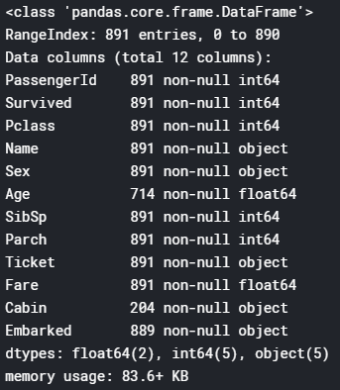
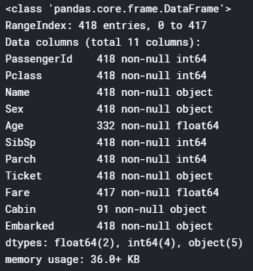
Loading Data
train_df.info() test_df.info()
Columns having missing values are
1.Train data - Age,Embarked, Cabin
2.Test data - Age, Cabin

Slide 15
First Look
Look for the obvious. (relationships)
Look for missing or incomplete data.
Start to consider what data to keep and what to drop.

Slide 16
What is Important
Observation
Out of 891 survived, 577 are male(~65%).
Most of the survived(644) embarked from port S(~72%).
Analysis
Age and Embarked play a important role in suvival rate.
Action
We need to fill the missing values.

Slide 17
What is not Important
We also need to drop certain features...
Observation
Cabin is highly incomplete- drop this feature
Passenger ID, Name and Ticket may also be dropped as they are irrelevant in determining the survival.
Could you determine the 'class'/'status' of the person from their name?

Slide 18

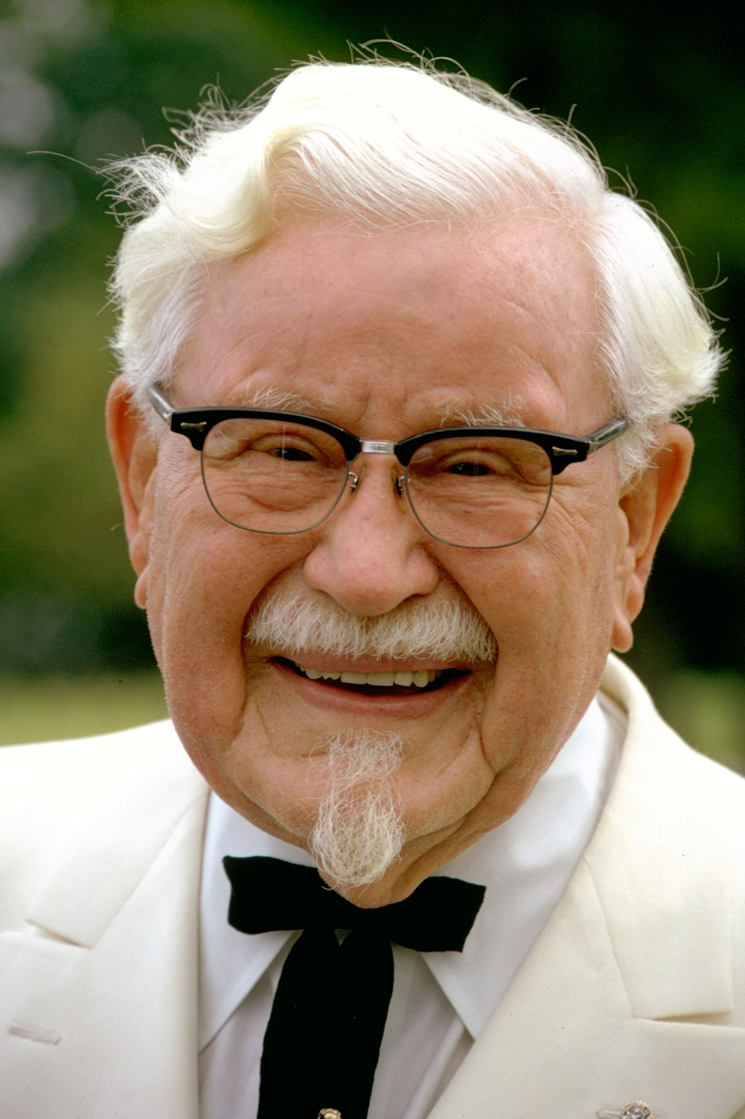
Kernel, Kernel Trick, Kernel Function
Has nothing to do with KFC.
In machine learning, a “kernel” is usually used to refer to the kernel trick, a method of using a linear classifier to solve a non-linear problem.
The kernel trick entails transforming linearly inseparable data- to linearly separable ones.
The kernel function is what is applied on each data instance to map the original non-linear observations into a higher-dimensional space in which they become separable.

Slide 19
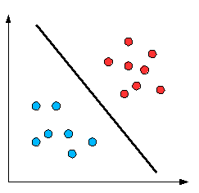
Hyperplane
A Hyperplane in two dimensional space.

Slide 20

Real-world Distribution
The red and blue dots cannot be separated by a straight line as they are "randomly distributed" and this, in reality, is how most real life problem data are -randomly distributed

Slide 21
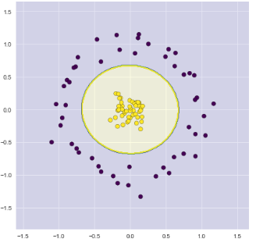
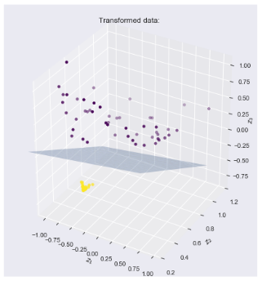
Visualize Hyperplane

Slide 22
Important Links
https://www.kaggle.com/c/titanic/overview
https://www.kaggle.com/sriloksagar/titanic-survival-prediction-98-accuracy

